Slide 1

GROUP
CHALLENGE
Telecom Churn Prediction
September 30, 2022
Alexander Tsibizov
Avinash Chekuru
Ella Cucui
Ling Yee Khor
Joana Duarte

Slide 2
TABLE OF CONTENTS
01
02
03
CHALLENGE OVERVIEW
OBJECTIVES
FEATURES & MODELLING
04
INSIGHTS & RECOMMENDATIONS
Notes:
•tenure vs. explanatory variables
•Slide with business questions we met
•Max density of churn is at tenure ~ 1 month (then decreases), what are the reasons for it? Could it be due to contracting specifics?
Ideas to check

Slide 3

01
CHALLENGE
OVERVIEW

Slide 4
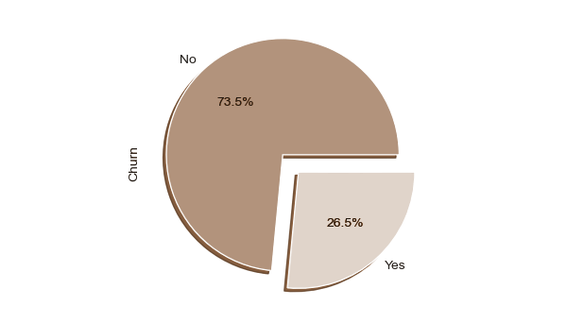
THE CHALLENGE
What is Churn?
Churn in a business setting refers to losing an acquired, potentially profitable customer. The definition of churn can vary by industry (in Healthcare, dead people are considered churn while in finance, people with inactive cards are called churned).
Acquiring a new customer is always more expensive than retaining an existing one. Hence, not letting them churn is the key to a sustained revenue stream.
Source: https://www.kaggle.com/datasets/blastchar/telco-customer-churn/discussion/263401

Slide 5
THE CHALLENGE
Why is it important to predict Customer Churn?
Predicting Churn before it happens gives businesses the ability to act proactively and prevent the loss of a customer.
Some proactive measures include:
Reaching out to high-risk customers and understand what needs are not being met;
More targeted re-engagement campaigns;
Re-evaluating larger, company-wide retention initiatives like pricing.
Source: https://mode.com/blog/predicting-and-preventing-churn/

Slide 6
THE CHALLENGE
The CAC (Customer Acquisition Cost) in the Telecom industry for American companies is $315 (one of the most expensive industries when it comes to CAC).
Data from 36 mobile CSPs across 24 countries shows annual churn rates can range anywhere from 14% to 75%.
Source: https://www.forbes.com/sites/forbestechcouncil/2020/10/30/acquiring-subscribers-is-only-half-the-battle/

Slide 7

02
OBJECTIVES

Slide 8
OBJECTIVES
PREDICTION
Predict churn
RECOMMENDATION
Improve strategic targeting
ACTION
Improve retention action based on customer features

Slide 9
PREDICT CHURN
METHODOLOGY
Number of Observations: 5986
Insights & Recommendations
Business Understanding
Data Understanding
Data Preparation
Modeling & Evaluation
No missing values;
Possible outliers were not removed (customers with more services and certain contract types have higher fees associated;
Train/Test split | 80/20
Based on the models, it is possible to perceive key features that impact the churning of the customer;
Insights and recommendations gathered based on these features.
What is Churn and how does it affect the Telecom Service Providers?
What are the features that have the most impact on customer churning?
Telecom Churn dataset which contains multiple customer features, such as gender, if the customer has dependents, what type of service or contract and churn.
Multiple models were built.
Model evaluation based on precision and recall.
Notes:
CRISP-DM

Slide 10

03
FEATURES &
MODELLING

Slide 11
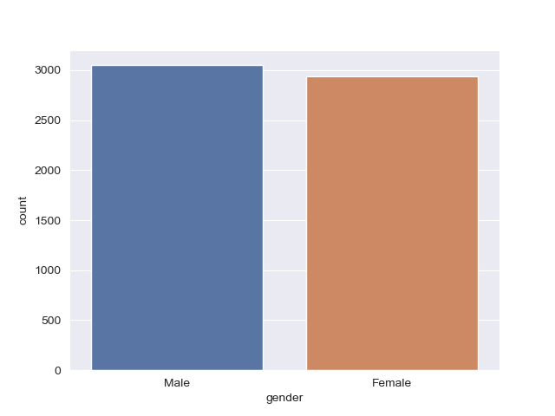
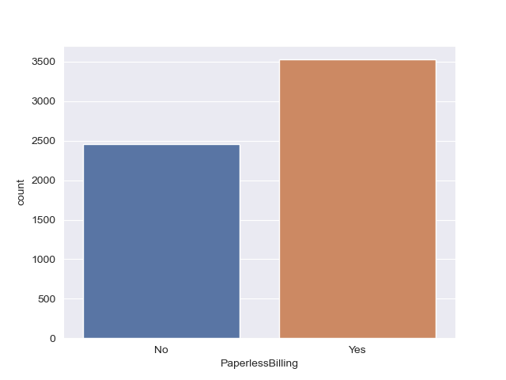
SOME OF THE FEATURES
Gender
Client gender (male/female)
Paperless Billing
Client’s preference (paper / paperless billing)

Slide 12
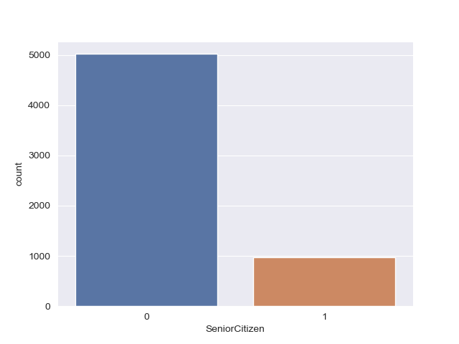
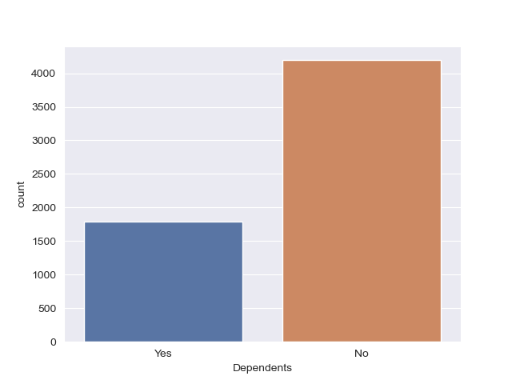
SOME OF THE FEATURES
Age Category
Client group (retired / not retired)
Dependents
Client has dependents (yes / no)

Slide 13
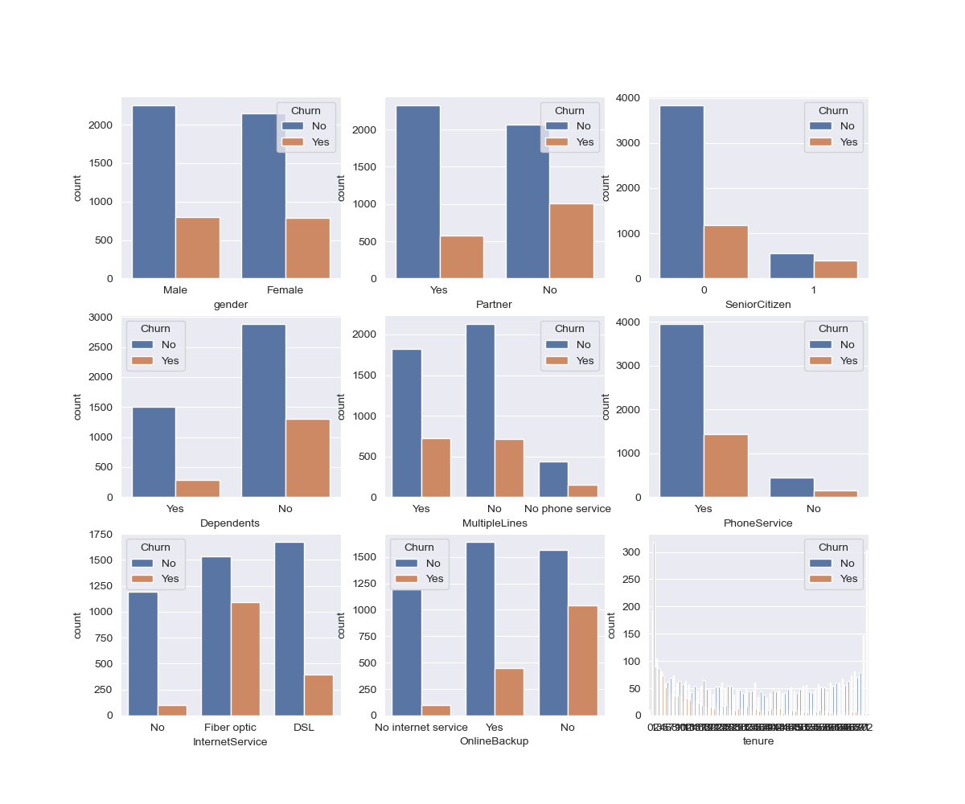
Churn / No Churn Feature Distribution

Slide 14
Churn / No Churn Feature Distribution
Feature: Tenure

Slide 15
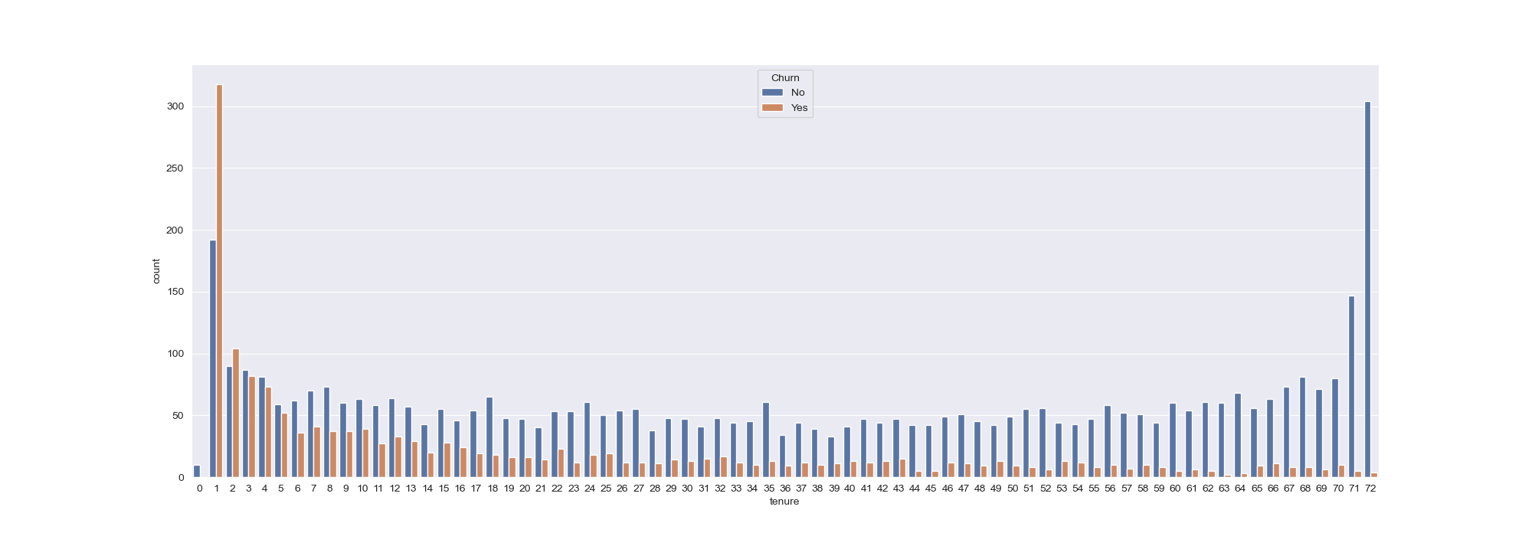
Tenure
How long (in months) a client has been with the service provider
?
?

Slide 16
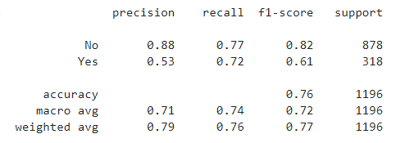
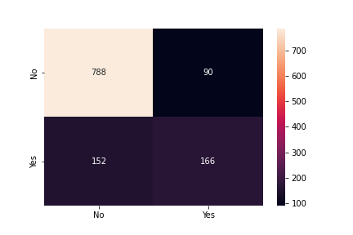
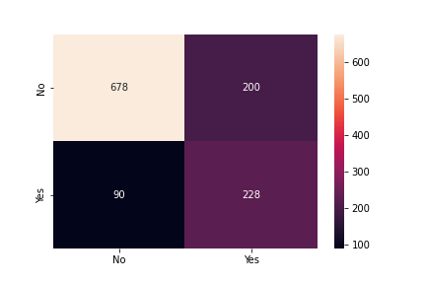
Logistic Regression Model
Approach to machine learning model:
80%-20% split
Categorical features hot encoded
Sampling Methodology
What does this mean?
72% of those who churn are predicted correctly by the model
- SMOTENC
+ SMOTENC

Slide 17

04
INSIGHTS & RECOMMENDATIONS

Slide 18
RECOMMENDATIONS
EXPLAINABLE ML
Top features of importance
SURVIVAL ANALYSIS
Additional insights

Slide 19
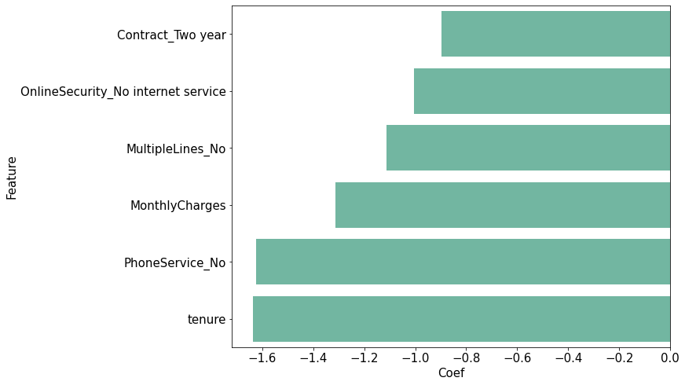
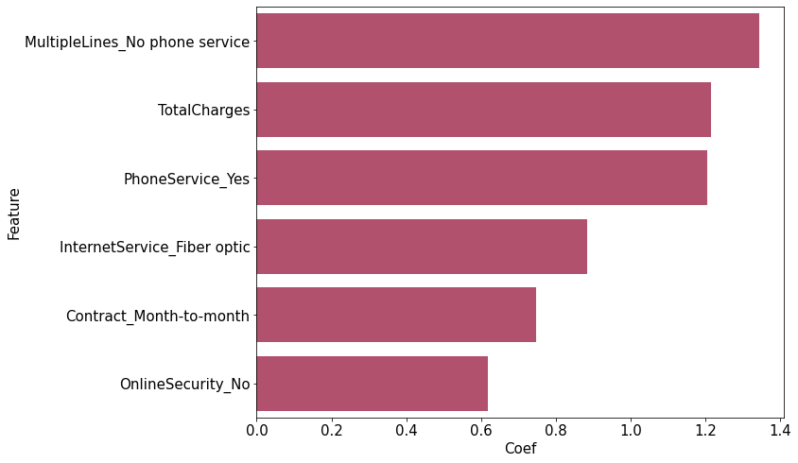
Explainable ML
Factors the reduce the risk of leaving
Factors the increase the risk of leaving

Slide 20
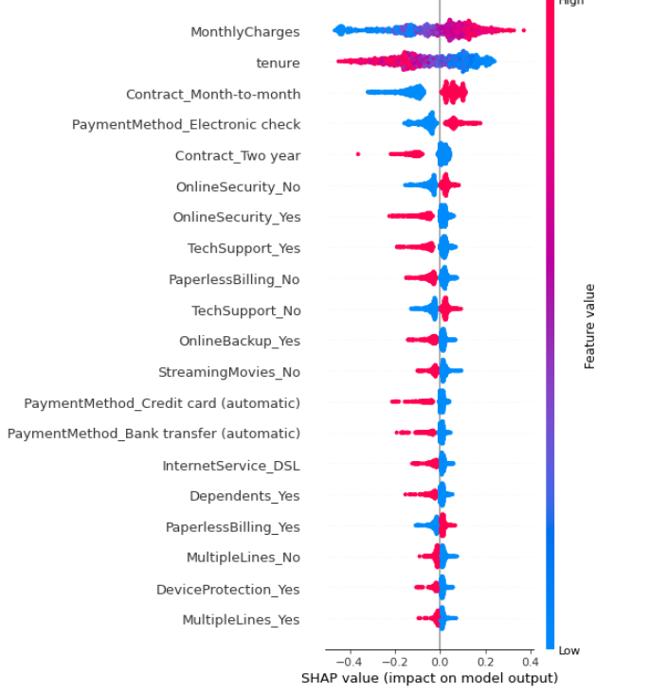
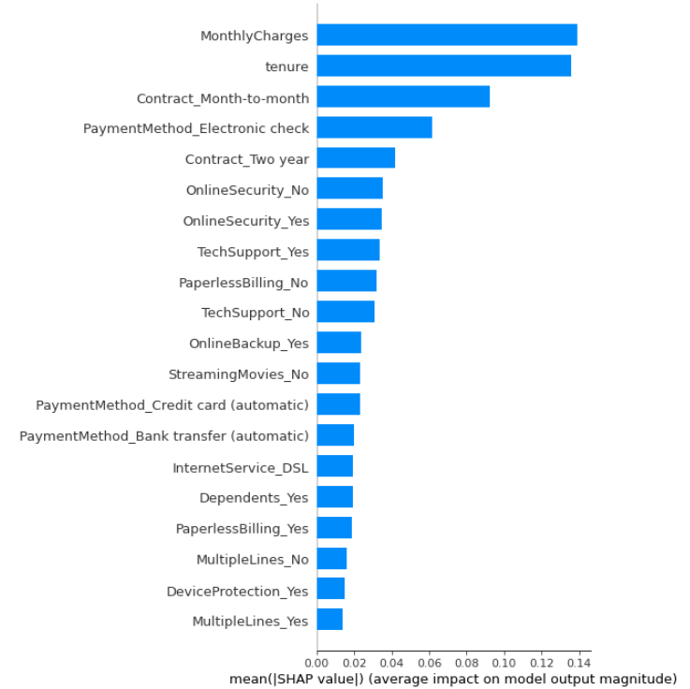
Global Interpretation
Based on 1000 samples

Slide 21
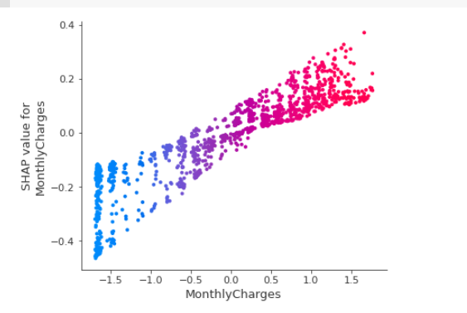
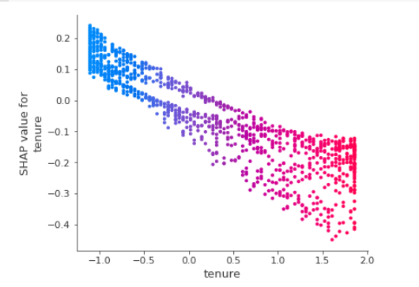
Global: Top 2 feature correlations with shapval

Slide 22
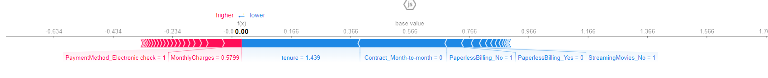
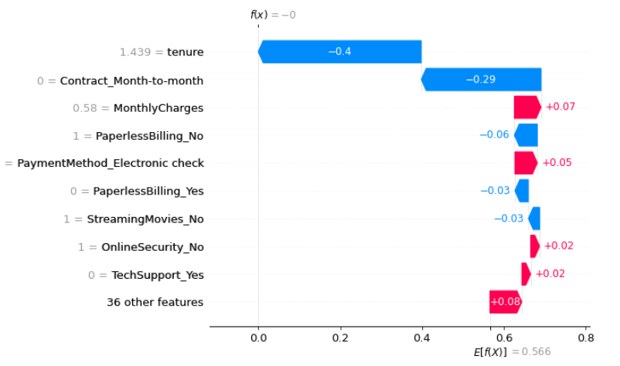
Local Interpretation: loyal

Slide 23
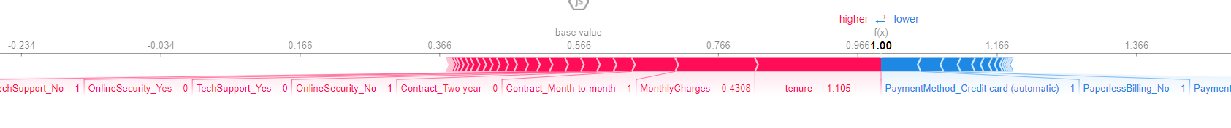
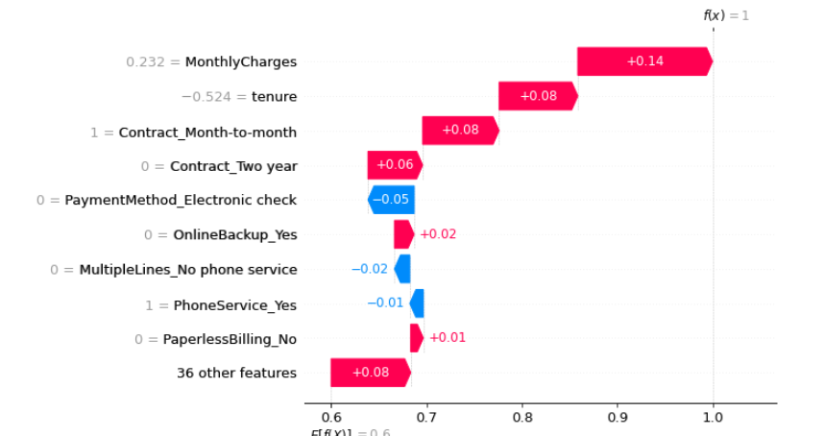
Local Interpretation: leaver

Slide 24
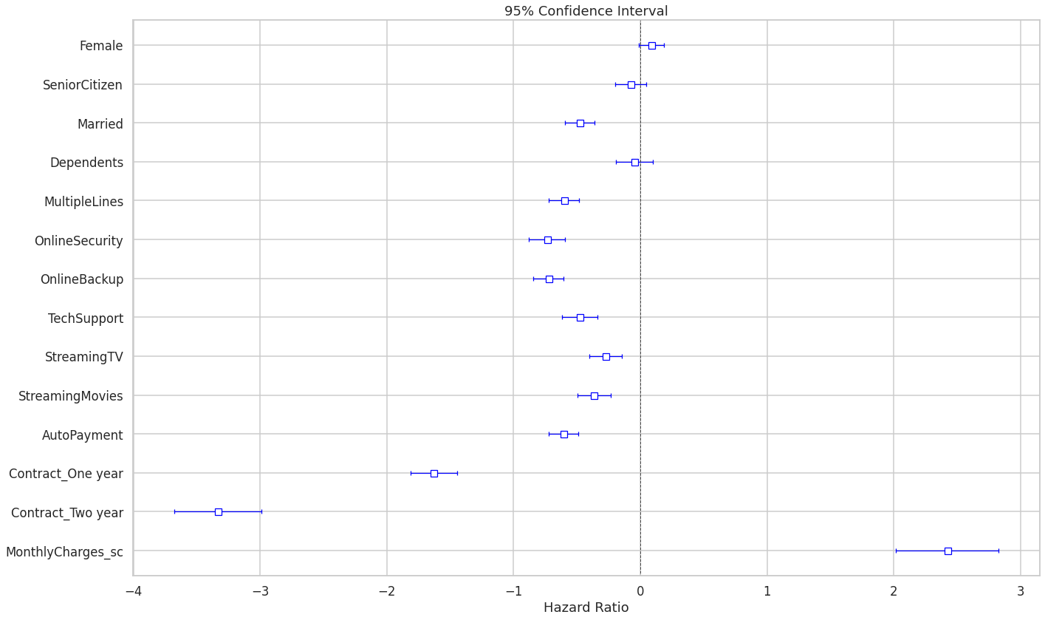
Survival Analysis
➭ An increase in $1 of monthly charges increases churning by 2%.
➭ Contract is the most effective way in reducing churning: one-year contract by 80% and two-year contract by 96%.
➭ Convenience such as automatic payment reduces churning by 45%.
➭ Customers with multiple phone lines are less likely to churn by 45%.
➭ Married customers are less likely to churn by a ratio of 38%.
➭ In terms of services provided, all the following help to reduce churning but at various degrees. Most important are online security and backup features which reduce churning by 52%, while entertainment features such as streaming TV and movies reduce churning by around 30%.

Slide 25
THANK YOU
QUESTIONS?
Alexander Tsibizov
Avinash Chekuru
Ella Cucui
Ling Yee Khor
Joana Duarte
Notes:
Challenge Overview - Joana
11 -15 -> Alexander

